Slide 1
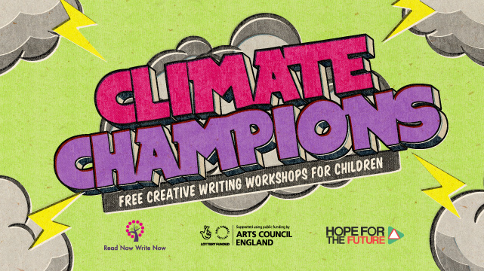

Slide 2
Housekeeping
Be Kind to everyone
Respect each other’s point of view and opinion
Health and Safety
Mobile Phones
Break Times
Ask Questions at Any Time.

Slide 3
Climate Champions 2021

Slide 4
Let’s have a look at the worksheet

Slide 8
Emotions
In real life and in stories it is important to let people know how you or your characters are feeling.

Slide 9
Showing our emotions is an excellent way of storytelling

Slide 10
Example Emotions
Happy
Angry
Sad
Shocked / Scared

Slide 11
What do we know about Climate Change?

Slide 13
Story Structure
When writing any story, we always need to think of three main parts:
Characters
Where the story is set
What is your story about and what will happen.

Slide 14
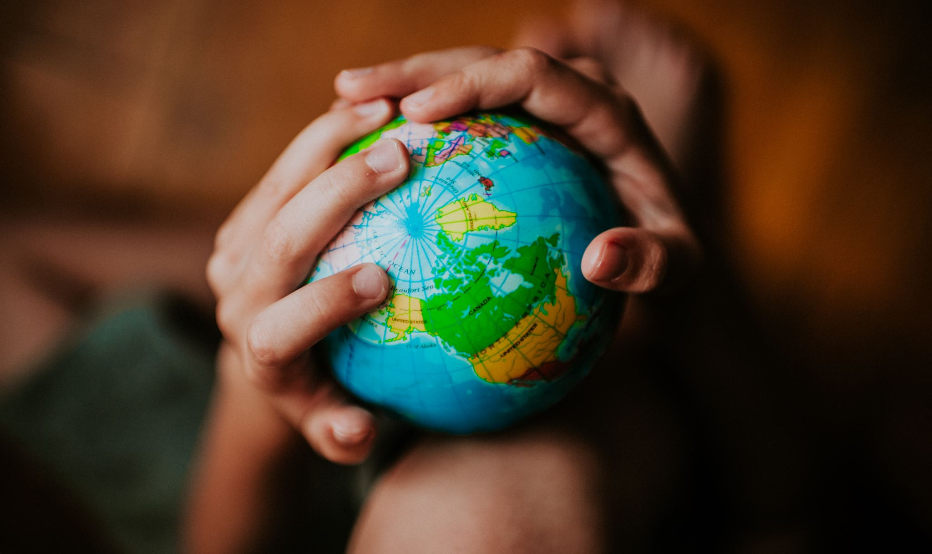
Story Structure
For our Climate Champion Story we will also:
Show your readers a climate change situation and make them feel the same emotions as you do.
Inspire them to become climate champions and do something positive by telling them a story – the story can be uplifting or sad.
Give them a moral that if we all do something we will save our planet.

Slide 15
Characters

Slide 16
Characters
Everyone can be a climate champion. You don’t have to be superhero with a cape!
When we create characters in stories, we can take inspiration from ourselves or others.
Let’s take a look at a famous climate champion.

Slide 17
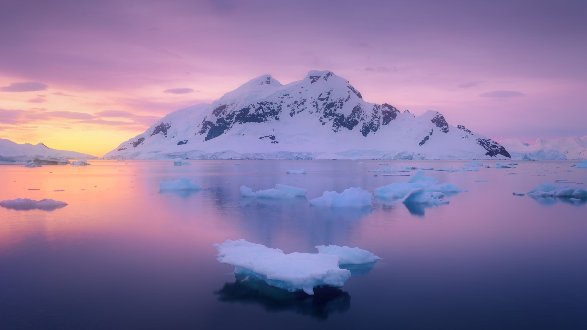
Do you do anything about climate change now?

Slide 18
Making Up a Character for your Story
You can make your character up or base it on yourself.
There are two main things to think about when creating a character.
What their character and personality is; such as are they clever, honest, determined, shy or outgoing.
What they physically look like; such as what colour is their hair or do they wear glasses.

Slide 19
What is character?

Slide 20
What is character
Our beliefs and values.
Our life experiences can shape our character.
Examples: be kind to everyone, caring about our friends and family, wanting to do good, being honest.

Slide 21
What is personality?

Slide 22
What is Personality
Our temperament, behaviours and how we act.
Examples: Think about things before we act, rush in to do things quickly, determined, shy, quiet, noisy, funny, extroverted.

Slide 23
Examples in Literature:
Harry Potter
Character & Personality
Brave,
forgiving,
intelligent,
selfless,
loyal,
kind,
moody.

Slide 24
Examples in Literature
Hermione Granger
Character & Personality
Clever,
Level- headed,
Studious
logical,
bossy,
impatient
Loyal.

Slide 25
Examples in Literature
Rubeus Hagrid
Character & Personality
Warm, caring & kind-hearted,
courageous, loyal,
emotional,
hard-working,
insecure,
forgetful,
Sensitive & fatherly.

Slide 26
Examples in Literature
Neville Longbottom
Character & Personality
Clumsy,
Shy, insecure & timid,
bumbling,
sensitive,
determined,
kind,
noble, brave & heroic

Slide 27
Do you have a favourite real person or character from a story who you admire?

Slide 28
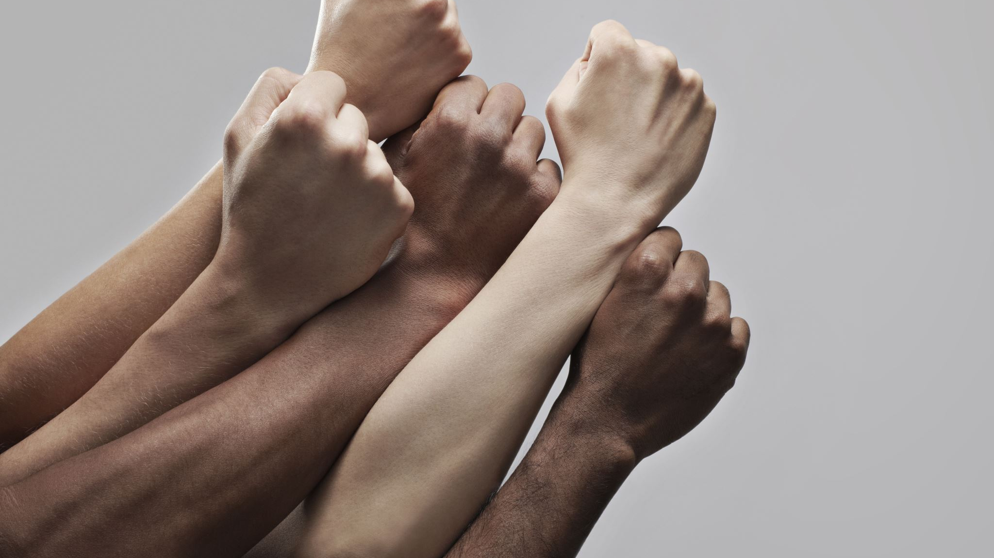
What sort of character & personality do you think a climate champion needs to have?

Slide 29
What sort of character & personality do you have?

Slide 30
If you are not basing your character entirely on yourself, write down here what their character and personality are.

Slide 31
What does your main character look like?

Slide 32
What does your main character look like?
Use colour to describe their skin, hair, clothes and eyes.
What age are they?
Do they have any specific features such as glasses, freckles or a scar(!)
What does their hair look like e.g. in a bob, long, curly, messy.
Think of the other senses such as smell and sound e.g. how do they talk.
Is there anything else?

Slide 33
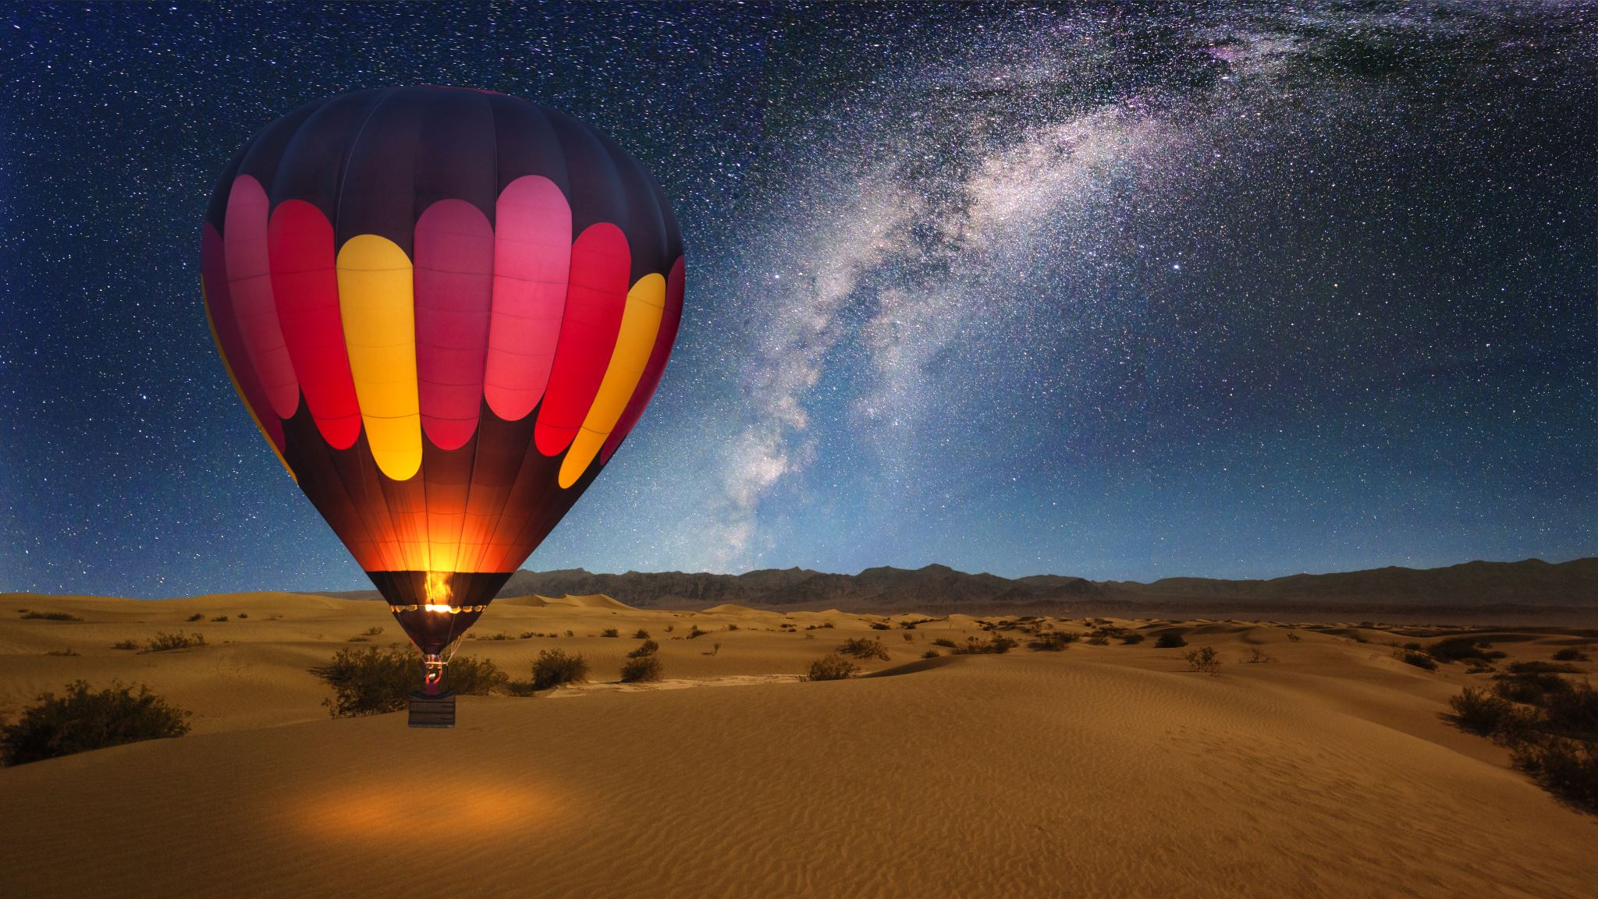
Do you have a name for your character?

Slide 34
Your Story: What is your story about?
Your story will be about an inspirational climate champion who encourages / motivates others to help reduce climate change.
To help you think about your story, let’s find out more about:
What climate change is
The causes of climate change
The consequences
What can be done.

Slide 35
What is Climate Change? (BBC Bitesize)
Climate change refers to changes in the Earth’s average temperature over a long period of time. If you were to look at a graph of the annual global temperature change, you can clearly see that since 1880 the temperature in a very short period time, relative to millions of years has increased dramatically. Recently, the rate of this change has been speeding up.
These changes can occur naturally over time, but most scientists think that human behaviour is increasing the amount of greenhouse gases in the atmosphere, which is causing these more rapid changes to the climate.
A lot of people consider climate change the most important crisis facing the world today and use terms like climate emergency or climate crisis to remind us of the gravity of the situation.

Slide 36
Causes of Climate Change
The major cause of climate change is the burning of fossil fuels. Burning fossil fuels releases carbon dioxide (and other Greenhouse gases) into the atmosphere, which traps heat radiating from Earth toward space. We call this the greenhouse effect. Too much fossil fuel has been burnt in the last 80 years and therefore too much carbon dioxide has been released into the atmosphere.
In 1750, 280 parts per million of carbon dioxide was in the atmosphere, in May 2020, scientists found that had increased to 417 parts per million.

Slide 37
Causes of Climate Change
Although the burning of fossil fuels is the main cause of climate change there are other contributing factors:
Deforestation: During photosynthesis trees absorb carbon dioxide. However, cutting them down means there is more carbon dioxide released into the atmosphere as the trees are no longer there to store and remove the carbon dioxide, furthermore, burning them releases the carbon they had stored.
Agriculture: Farming practices are responsible for releasing greenhouse gases into the air. In Northern Ireland, the large amounts of grazing animals (cows and sheep) are responsible for nearly 30% of all our carbon emissions.
Landfill: When biodegradable waste such as food, paper and card is sent to landfill sites - it releases methane gas into the atmosphere.

Slide 38
Consequences: Extreme Weather
Weather patterns and seasons could change. Heavy rainfall can lead to floods and decreasing water quality while droughts and heatwaves can put pressure on water supplies. People will experience a different climate and weather to what they have become used to.

Slide 39
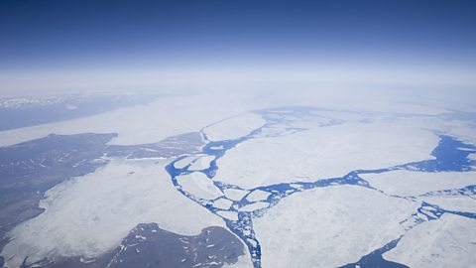
Consequences: Shrinking Glaciers and Melting Ice Caps.
Across the world ice is melting which is contributing to the rising sea levels across the planet. Glaciers are found in cold, mountain areas and these will melt as global temperatures increase.
These ice caps are vital for a stable world temperature as they reflect back the sun’s light and keep the planet cool. If they disappear, we risk the world heating up even more and at a faster rate.

Slide 40
Consequences: Rising Sea Levels
Sea levels are rising by around 3.2 mm per year which threatens cities and low-lying farmland around the world, potentially affecting more than 80 million people. In Bangladesh, a rise in water level of just 1m could flood over 25% of the land.

Slide 41
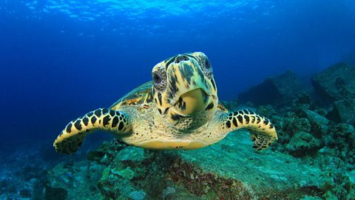
Consequences: Extinction of Plants and Animals
Due to climate change species around the world are being forced to migrate and adapt to new environments. Their ability to do that will determine whether they survive or become extinct. Animals and plants will start to die off as the climate changes.

Slide 42
What Can be Done?
Food consumption: eat less meat and more food that’s produced locally.
Fly less: if it’s the only option pick a destination close by, fly economy and choose to carbon offset.
Reduce car journeys: where possible cycle, walk or use public transport to get to school.
Get involved: find out about organisations that campaign for environmental change.
Green spaces: protect them and if possible, plant trees or introduce plants into your household.
Change your buying habits: avoid single-use items and only purchase clothes you really need.
Recycle your unwanted clothes: donate to clothing banks and charity shops or sell them on.
Use less energy: at home switch off lights and appliances when you’re not using them.

Slide 43
Mersey Barrage

Slide 44
Your Story: We need to think of the following
What part of climate change will we write about
What can we do to tackle it and inspire others to do something about it.

Slide 45
Your Story
What part of climate change worries you the most / would you like to write about?
Do you think we can still do something before it is too late?
What do you think we can do?

Slide 46
Your Story: What Will Happen?
The plot is basically what is going to happen in your story. Over thousands of years, authors have used basic plot structures to help them think of the start, the middle and the end of their story and in all sorts of different genres. Some stories contain lots of plots, some only one.

Slide 47
Overcoming the Monster
This is most common of all plot types. In the story there is a baddie (the antagonist) who is threatening to do something against our main character (or the world). The monster could be a person, an organisation, a government or a company.

Slide 48
Quest
To overcome the monster, sometimes the main character has to go out on an adventure facing obstacles on the way.

Slide 49
Tragedy
Sometimes you cannot overcome the monster and there is no happy ending.

Slide 50
Rebirth
This is where the main character starts off as a sort of anti-hero, not so nice and kind but, through a series of events, realises the error of their ways and changes before it is too late.

Slide 51
Which plot or plots do you want to have in your story?

Slide 52
Dilemma
A dilemma is the problem the main character has to face in a story. In all stories there must be some sort of dilemma for your main character to face.
The main dilemma in our stories isn’t climate change itself but the causes of climate change.
Please remember, there is no easy way to fix the causes of climate change. As much as we would love to snap our fingers and make them go away, it is going to take some time and all of us to sort things out.

Slide 53
Thinking about the plot types can help. Do you?
Overcome a dilemma about climate change by taking action or by speaking to people in charge?
Go on a quest facing problems like people saying no to you (but in the end succeed)?
Find it really difficult to do anything, despite all your best efforts, because there is not enough support (and therefore your story is a tragedy).
Manage to persuade someone who previously did not want to help fight the climate change problem to now do so (and this would be a rebirth story)

Slide 54
Who can help or stop us
Friends
Politicians
School
Family
Neighbours
Companies
Any Others?

Slide 55
Your Story: Where is it set?

Slide 56
Setting the Scene
Our stories need to start somewhere. Straight away let’s get our readers emotional about what is going on by creating a heart-breaking scene about climate change.
Describing scenes is a very good way of starting a home movie in readers imaginations.

Slide 57
Your Story: How to set a scene?
What the weather is like
What is in the scene (using colour helps readers visualise the scene)
What other senses are in the scene? For example: what noises or smells are there?
Is there any movement? For example: is it windy or raining or are there people or animals doing something in particular?
Think of a poor innocent animal or child suffering because of what is going on and describe this in the setting.

Slide 58
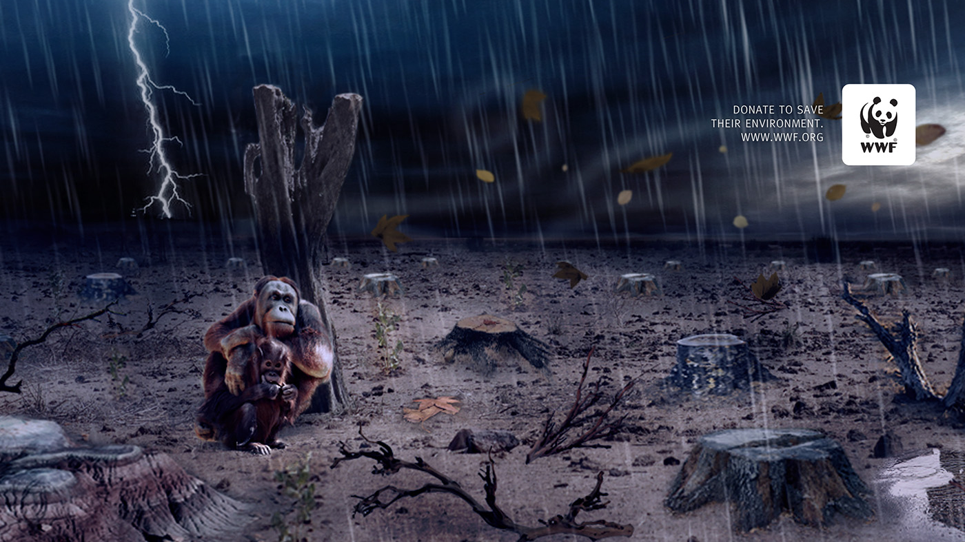

Slide 59
Now where will your first scene be set?

Slide 60
A Moral for your Story

Slide 61
What is a moral?

Slide 62
What is a Moral?
A message or a lesson to be learned from the story.

Slide 63
Examples
It is not too late to help fight climate change.
We all need to work together to stop climate change.
Do all you can to stop climate change
It’s never too late to do the right thing
Together, we can make a better future
Young or old we can make a change
Together we can win
If you ignore things they will get worse
There is no planet B, even though I’m young I can still be a climate champion

Slide 64
Planning Your Story

Slide 65
Thank you for joining our course and being a Climate Champion!

